Slide 2
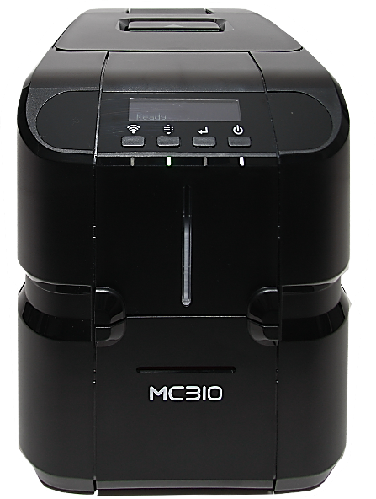
Consumables guide
MC310: Ribbon range
Platinum line and Diamond line ribbons

Slide 3
Consumables guide
Ribbon ranges
Platinum line and Diamond line ribbons
Formats | ** | ***
Price | $ | $$
Quality | *** | ***
Secure ribbons | * | ***
Pt

Slide 4
Consumables guide
MC310: Diamond line ribbons
Film Name | Ribbon panels – color dye sublimation | Capacity | Product code
YMCKO |  | 250 | PR20319301
YMCKOK |  | 200 | AVAILABLE Q3
Half YMCKO |  | 400 | AVAILABLE Q3

Slide 5
Consumables guide
MC310: Platinum line ribbons
Film Name | Ribbon panels – color dye sublimation | Capacity | Product code
YMCKO |  | 250 | PR20307301
YMCKOK |  | 200 | PR20307302
Half YMCKO |  | 400 | PR20307303
Half YMCKO |  | 250 | PR20307315
YMCScKO |  | 200 | AVAILABLE Q3
YMCUvKO |  | 200 | AVAILABLE Q4
UcYMCK |  | 250 | AVAILABLE Q3
KO |  | 600 | PR20305304
Pt

Slide 6
Consumables guide
MC310: Platinum line ribbons
Film Name | Ribbon panels – thermal transfer | Capacity | Product code
K |  | 2000 | PR20314305
White |  | 1000 | PR20314308
Red |  | 1000 | PR20314309
Blue |  | 1000 | PR20314312
Green |  | 1000 | PR20314311
Silver |  | 500 | PR20314306
Gold |  | 500 | PR20314307
Scratch off |  | 1000 | PR20314313
Pt

Slide 7
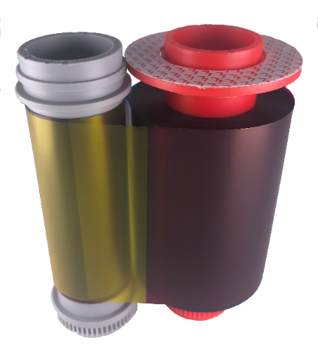
Consumables guide
MC310: YMCKO ribbon 250 prints
The chromXpert® YMCKO ribbon is developed and harmonized for the use with Matica MC310 printers.
The ribbon consists of three full size dye sublimation color panels (Yellow, Magenta and Cyan),
One full size thermal transfer resin panel (K-Black)
One full size clear overlay panel (O).
With the color panels, up to 16.7 million vivid colors can reproduced, the thermal transfer K panel ensures crisp and sharp text and barcode printing. The varnish type overlay panel protects the printed information and make them remain long-lasting on the card. This ribbon is perfect for printing on PVC card material or any other card materials with a PVC top coating.
The YMCKO ribbon comes with an embedded RFID tag for automatic ribbon detection in the MC310 printer. Detecting the correct RFID tag, the MC310 automatically set the optimized printer parameters to ensure always the best printing quality. The embedded RFID tag can also be programmed with a unique customer or project code to prevent the use of non-authorized ribbons, which might cause problems with the printer and will not provide the expected print quality.
Storage Conditions:
Temperature: < 25°C Humidity: less than 60% (non-condensing) Storage: Dry and dark place Shelf life-time: 12 month
Operating Conditions:
Temperature: 15°C – 30°C Humidity: 30-70% (non-condensing)
MC310 YMCKO ribbon dimensions:

Slide 8
Consumables guide
MC310: YMCKOK ribbon 200 prints
The chromXpert® YMCKOK ribbon is developed and harmonized for the use with Matica MC310 printers.
The ribbon consists of three full size dye sublimation color panels (Yellow, Magenta and Cyan)
Two full size thermal transfer resin panels (K-Black)
One full size clear overlay panel (O)
The second resin K-Black panel is used to print text and/or barcodes on the reverse of the card in full black.
The color panels, up to 16.7 million vivid colors can reproduced, the thermal transfer K-Black panel ensures crisp and sharp text and barcode printing. The varnish type overlay panel protects the printed information and make them remain long-lasting on the card. This ribbon is perfect for printing on PVC card material or any other card materials with a PVC top coating
The YMCKOK ribbon comes with an embedded RFID tag for automatic ribbon detection in the MC310 printer. Detecting the correct RFID tag, the MC310 automatically set the optimized printer parameters to ensure always the best printing quality. The embedded RFID tag can also be programmed with a unique customer or project code to prevent the use of non-authorized ribbons, which might cause problems with the printer and will not provide the expected print quality.
Storage Conditions:
Temperature: < 25°C Humidity: less than 60% (non-condensing) Storage: Dry and dark place Shelf life-time: 12 month
Operating Conditions:
Temperature: 15°C – 30°C Humidity: 30-70% (non-condensing)
MC310 YMCKOK ribbon dimensions:

Slide 9
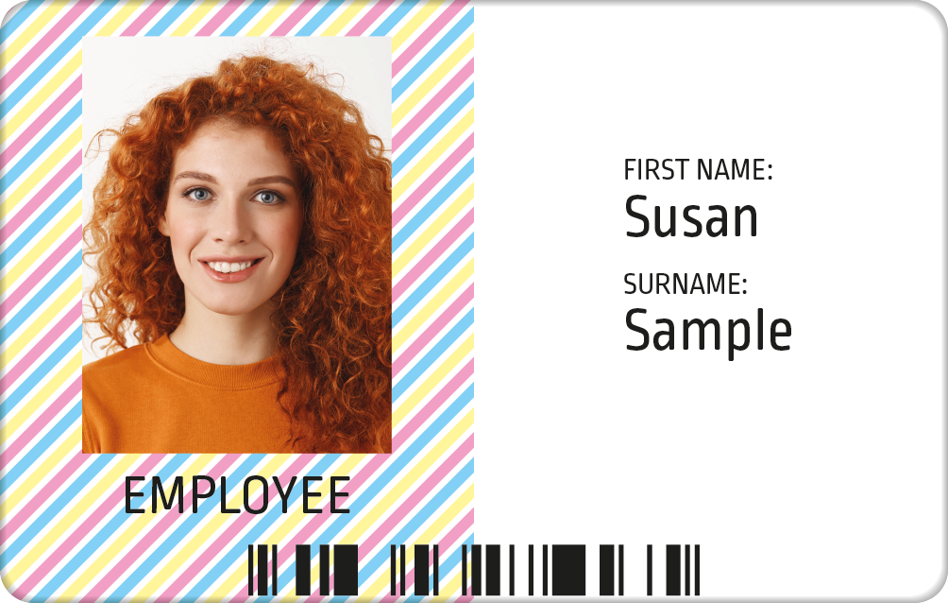
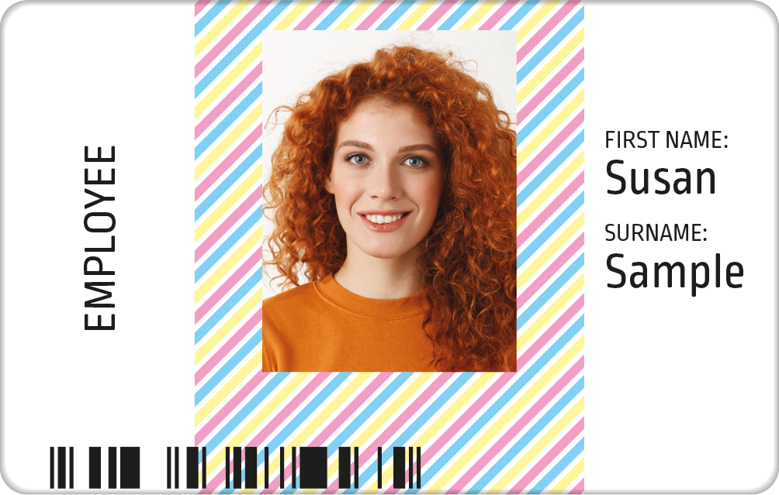
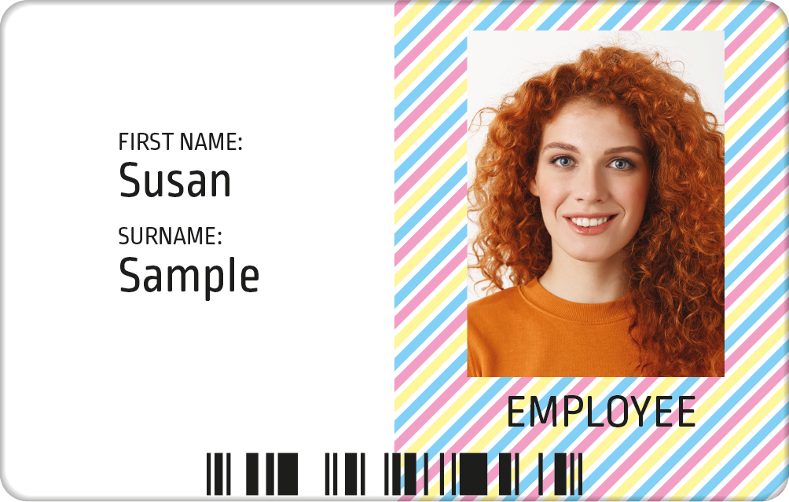
Consumables guide
MC310: ymcKO ribbon 400 prints
Card front:
Half color area on the left,
Full black and overlay
The chromXpert® ymcKO ribbon is developed and harmonized for the use with Matica MC310 printers.
The ribbon consists of three half size dye sublimation color panels (Yellow, Magenta and Cyan)
One full size thermal transfer resin panel (K-Black)
One full size clear overlay panel (O).
The color panels, up to 16.7 million vivid colors can reproduced, the thermal transfer K-Black panel ensures crisp and sharp text and barcode printing. The varnish type overlay panel protects the printed information and make them remain long-lasting on the card. This ymcKO ribbon is perfect for printing on PVC card material when the color elements (portrait photo or color logo artwork) is always located on the same card position and same size. The black data can be printed in resin K-Black on front and/or the backside of the card.
The ymcKO ribbon comes with an embedded RFID tag for automatic ribbon detection in the MC310 printer. Detecting the correct RFID tag, the MC310 automatically set the optimized printer parameters to ensure always the best printing quality. The embedded RFID tag can also be programmed with a unique customer or project code to prevent the use of non-authorized ribbons, which might cause problems with the printer and will not provide the expected print quality.
Card front:
Half color area in the center,
Full black and overlay
Card front:
Half color area on the right,
Full black and overlay
Storage Conditions:
Temperature: < 25°C Humidity: less than 60% (non-condensing) Storage: Dry and dark place Shelf life-time: 12 month
Operating Conditions:
Temperature: 15°C – 30°C Humidity: 30-70% (non-condensing)
MC310 ymcKO ribbon dimensions:

Slide 10
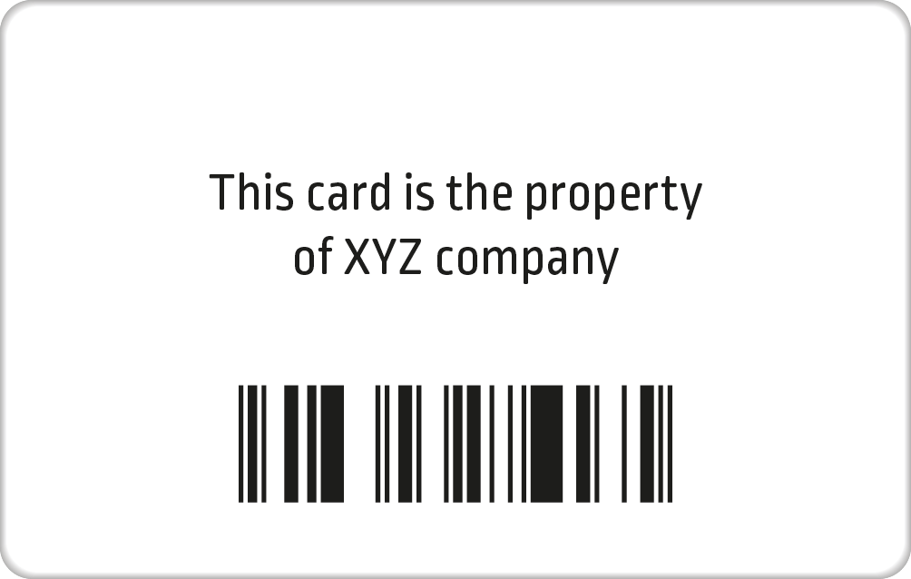
Consumables guide
MC310: ymcKOKO ribbon 250 prints
The chromXpert® ymcKOKO ribbon is developed and harmonized for the use with Matica MC310 printers.
The ribbon consists of three half size dye sublimation color panels (Yellow, Magenta and Cyan)
Two full size thermal transfer resin panels (K-Black)
Two full size clear overlay panels (O).
The color panels, up to 16.7 million vivid colors can reproduced, the thermal transfer K-Black panels ensures crisp and sharp text and barcode printing. The varnish type overlay panel protects the printed information and make them remain long-lasting on front and backside of the card.
The ymcKOKO ribbon is perfect for printing on PVC card material when the color elements (portrait photo or color logo artwork) is always located on the same card position and same size. The black data can be printed in resin K-Black on front and backside of the card.
The ymcKOKO ribbon comes with an embedded RFID tag for automatic ribbon detection in the MC310 printer. Detecting the correct RFID tag, the MC310 automatically set the optimized printer parameters to ensure always the best printing quality. The embedded RFID tag can also be programmed with a unique customer or project code to prevent the use of non-authorized ribbons, which might cause problems with the printer and will not provide the expected print quality.
Card front:
Half color area on the left,
Full black and overlay
Card front:
Half color area in the center,
Full black and overlay
Card front:
Half color area on the right,
Full black and overlay
Card reverse:
Full card area Black and Overlay
Storage Conditions:
Temperature: < 25°C Humidity: less than 60% (non-condensing) Storage: Dry and dark place Shelf life-time: 12 month
Operating Conditions:
Temperature: 15°C – 30°C Humidity: 30-70% (non-condensing)
MC310 ymcKO ribbon dimensions:

Slide 11
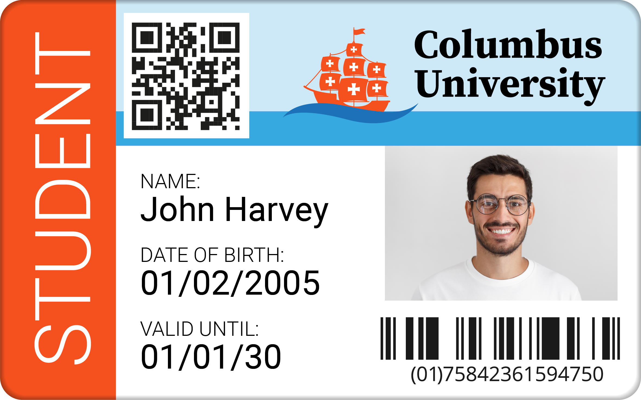
Consumables guide
MC310: YMCKOKO ribbon 200 prints
The chromXpert® YMCKOKO ribbon is developed and harmonized for the use with Matica MC310 printers.
The ribbon consists of three full size dye sublimation color panels (Yellow, Magenta and Cyan)
Two full size thermal transfer resin panels (K-Black)
Two full size clear overlay panels (O)
The color panels, up to 16.7 million vivid colors can reproduced, the thermal transfer K-Black panel ensures crisp and sharp text and barcode printing on both sides of the card. The varnish type overlay panel protects the printed information and make them remain long-lasting on both sides of the card.
The YMCKOKO ribbon is perfect for printing on PVC card material or any other card materials with a PVC top coating. The YMCKOKO ribbon comes with an embedded RFID tag for automatic ribbon detection in the MC310 printer. Detecting the correct RFID tag, the MC310 automatically set the optimized printer parameters to ensure always the best printing quality.
The embedded RFID tag can also be programmed with a unique customer or project code to prevent the use of non-authorized ribbons, which might cause problems with the printer and will not provide the expected print quality.
Card front:
Full card color printing
Full card Black and Overlay printing
Card reverse:
Full card Black and Overlay printing
Storage Conditions:
Temperature: < 25°C Humidity: less than 60% (non-condensing) Storage: Dry and dark place Shelf life-time: 12 month
Operating Conditions:
Temperature: 15°C – 30°C Humidity: 30-70% (non-condensing)
MC310 YMCKOKO ribbon dimensions:

Slide 12
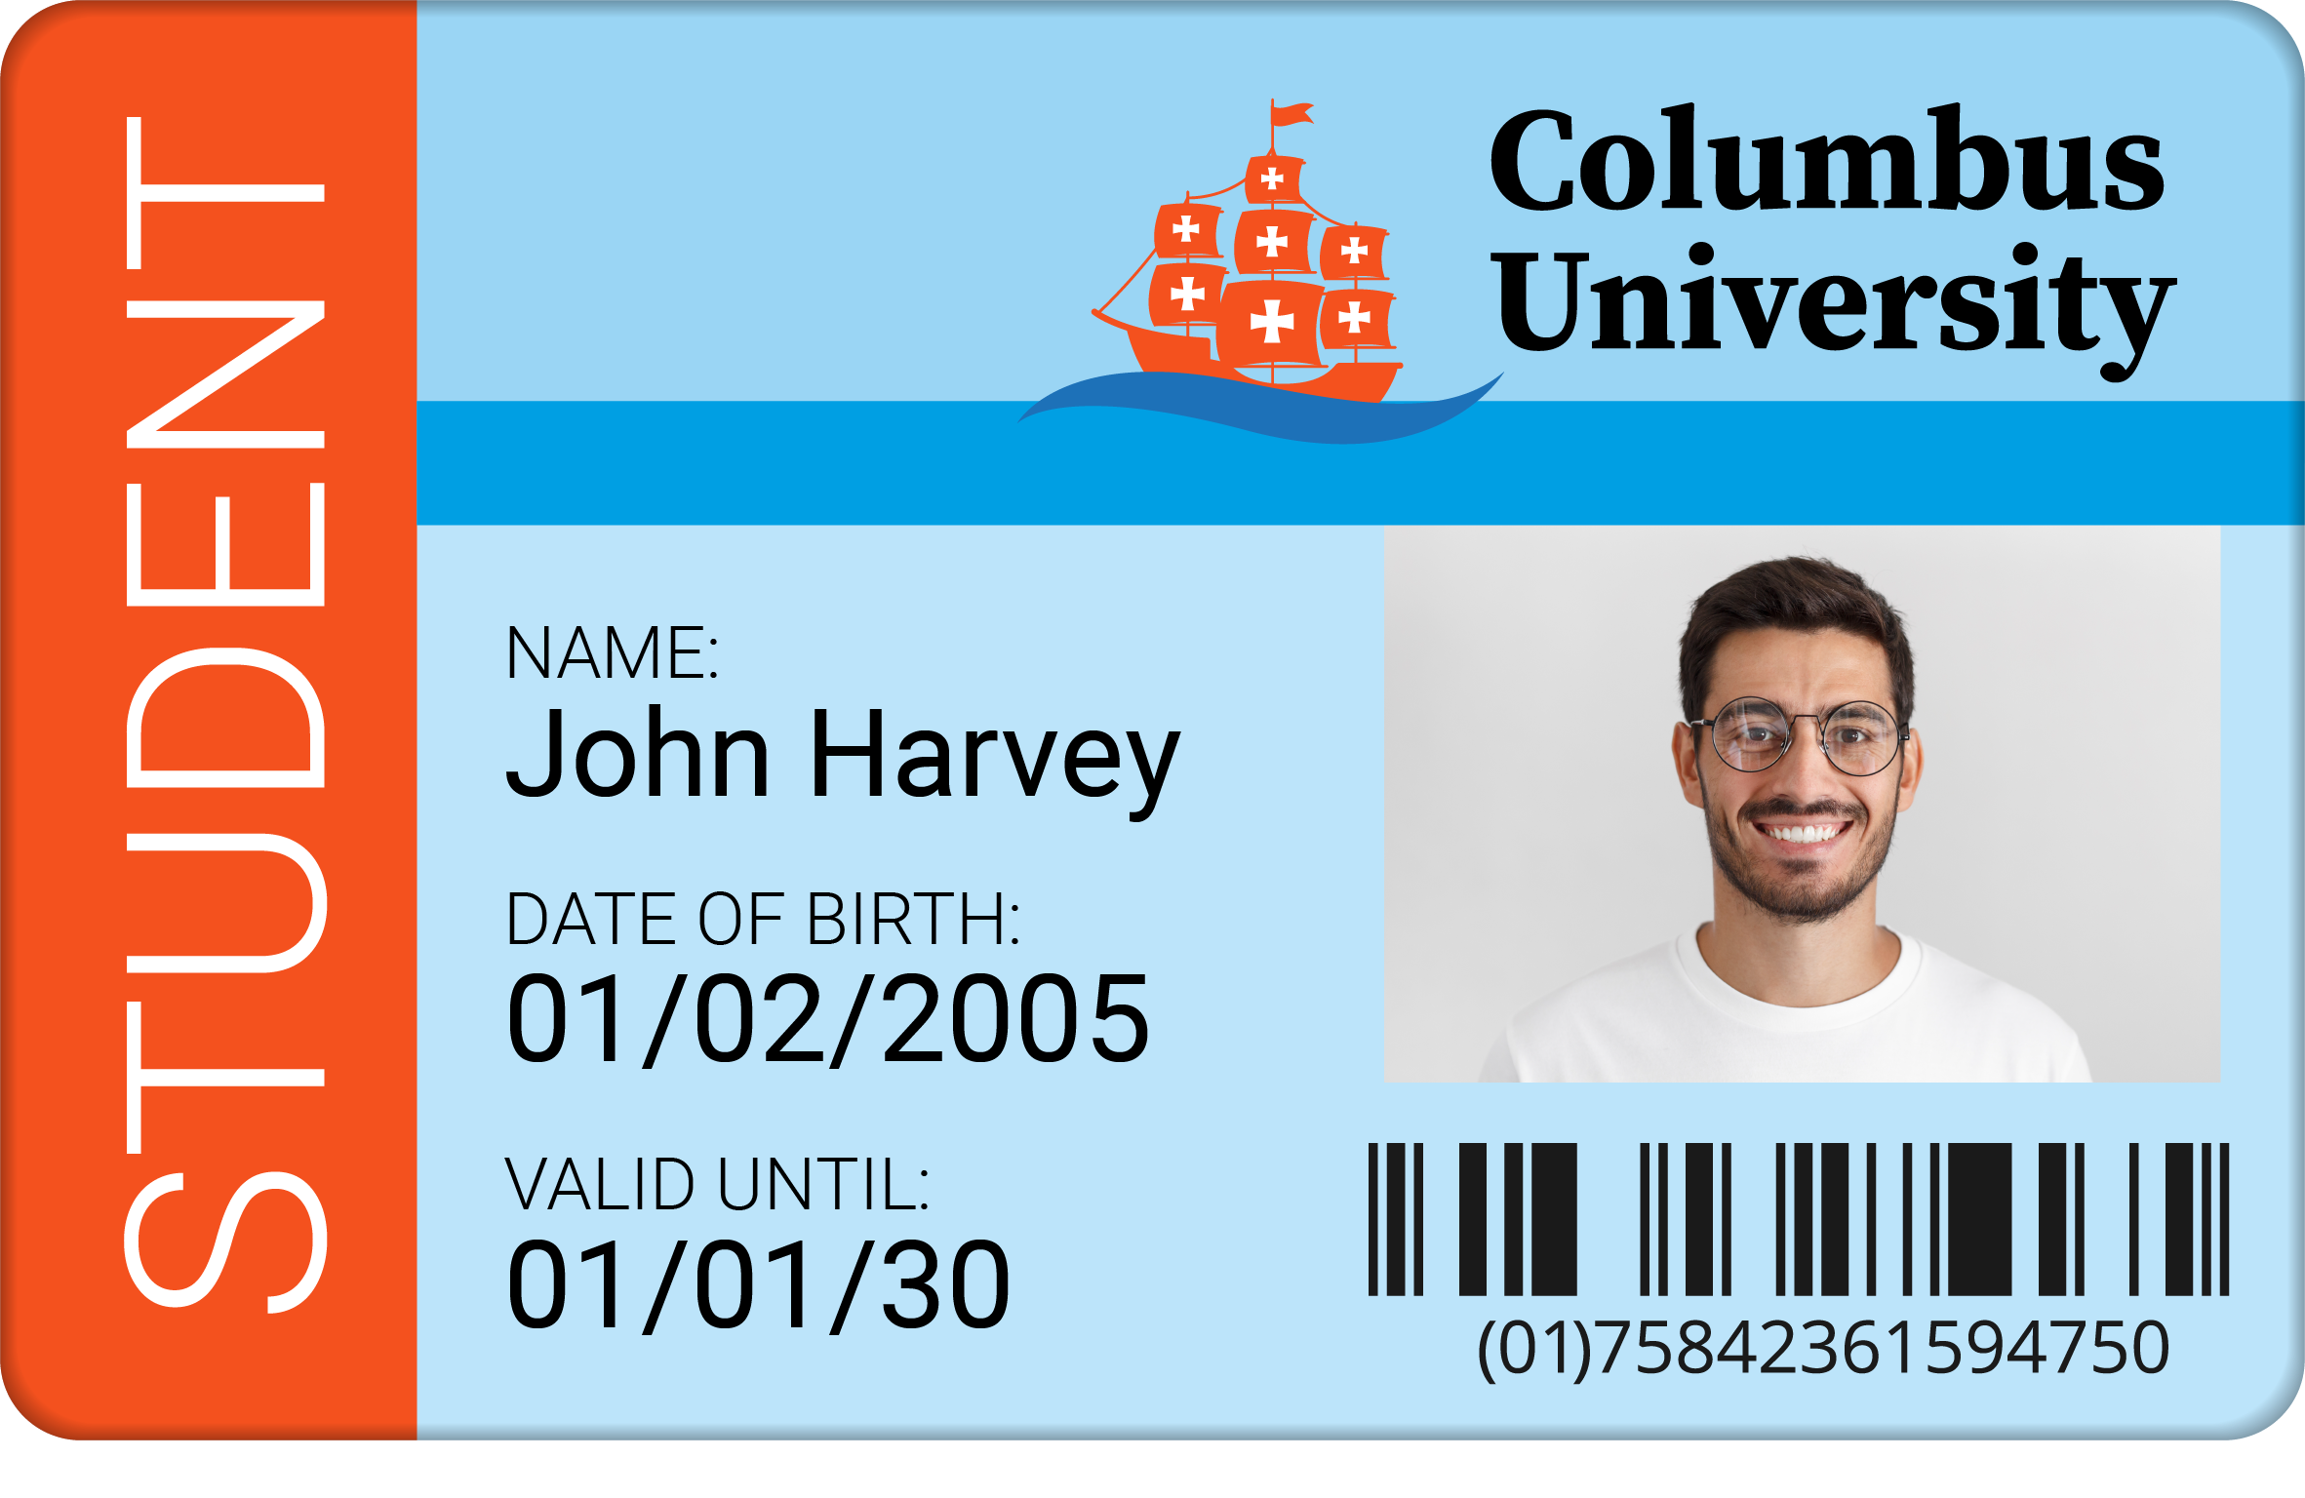
Consumables guide
MC310: YMCUvKO ribbon 200 prints
Card front:
Full card color printing
The chromXpert® YMCUvKO ribbon is developed and harmonized for the use with Matica MC310 printers.
The ribbon consists of three full size dye sublimation color panels (Yellow, Magenta and Cyan)
One full size UV color ink panel (Uv)
A full-size thermal transfer resin panel (K-Black)
One full size clear overlay panel (O)
The color panels, up to 16.7 million vivid colors can reproduced, the thermal transfer K-Black panel ensures crisp and sharp text and barcode printing of the card. The varnish type Overlay panel protects the printed information and make them remain long-lasting on the card. The Uv (Ultraviolet) ink panel applies any graphic or text in Uv (Ultraviolet) ink, which appears only when the card is exposed to an ultraviolet light source. This ribbon type is perfect, when additional security is requested. This ribbon is perfect for printing on PVC card material or any other card materials with a PVC top coating
The YMCUvKO ribbon comes with an embedded RFID tag for automatic ribbon detection in the MC310 printer. Detecting the correct RFID tag, the MC310 automatically set the optimized printer parameters to ensure always the best printing quality. The embedded RFID tag can also be programmed with a unique customer or project code to prevent the use of non-authorized ribbons, which might cause problems with the printer and will not provide the expected print quality.
Card front:
Uv (ultraviolet) ink Bitmap
Card front:
Final card with Uv (ultraviolet) print applied
Storage Conditions:
Temperature: < 25°C Humidity: less than 60% (non-condensing) Storage: Dry and dark place Shelf life-time: 12 month
Operating Conditions:
Temperature: 15°C – 30°C Humidity: 30-70% (non-condensing)
MC310 YMCUvKO ribbon dimensions:

Slide 13
Consumables guide
MC310: YMCScKO ribbon 200 prints
Card front:
Full card color printing
The chromXpert® YMCScKO ribbon is developed and harmonized for the use with Matica MC310 printers.
The ribbon consists of three full size dye sublimation color panels (Yellow, Magenta and Cyan)
One full size security ink panel (Sc)
A full-size thermal transfer resin panel (K-Black)
One full size clear overlay panel (O)
The color panels, up to 16.7 million vivid colors can reproduced, the thermal transfer K-Black panel ensures crisp and sharp text and barcode printing of the card. The varnish type overlay panel protects the printed information and make them remain long-lasting on the card. The Sc (security) ink panel applies any graphic or text using a security ink (Sc), which appears only when the card is tilted. This ribbon type is recommended, when additional security is requested. This ribbon is perfect for printing on PVC card material or any other card materials with a PVC top coating.
The YMCScKO ribbon comes with an embedded RFID tag for automatic ribbon detection in the MC310 printer. Detecting the correct RFID tag, the MC310 automatically set the optimized printer parameters to ensure always the best printing quality. The embedded RFID tag can also be programmed with a unique customer or project code to prevent the use of non-authorized ribbons, which might cause problems with the printer and will not provide the expected print quality.
Card front:
Sc (security) ink Bitmap
Card front:
Final card with Sc (security) print applied
Storage Conditions:
Temperature: < 25°C Humidity: less than 60% (non-condensing) Storage: Dry and dark place Shelf life-time: 12 month
Operating Conditions:
Temperature: 15°C – 30°C Humidity: 30-70% (non-condensing)
MC310 YMCScKO ribbon dimensions:

Slide 14
Consumables guide
MC310: UcYMCK ribbon 200 prints
Step 1:
Blank non-PVC card
The chromXpert® UcYMCK ribbon is developed and harmonized for the use with Matica MC310 printers.
The ribbon consists of one full size Unichroma® panel (Uc)
Three full size dye sublimation color panels (Yellow, Magenta and Cyan)
A full-size thermal transfer resin panel (K-Black)
The color panels, up to 16.7 million vivid colors can reproduced, the thermal transfer K-Black panel ensures crisp and sharp text and barcode printing of the card. The Uc (Unichroma®) varnish panel applies a special coating onto the card surface prior to the color and black print. When using the Unichroma® ribbon it is possible to personalize PET and even PC cards with the MC310 direct-to-card printer.
The UcYMCK ribbon comes with an embedded RFID tag for automatic ribbon detection in the MC310 printer. Detecting the correct RFID tag, the MC310 automatically set the optimized printer parameters to ensure always the best printing quality. The embedded RFID tag can also be programmed with a unique customer or project code to prevent the use of non-authorized ribbons, which might cause problems with the printer and will not provide the expected print quality.
Step 2:
apply clear Unichroma® layer
Step 3:
Printing YMCK on non-PVC card
IMPORTANT:
Using the Unichroma® ribbon lamination after printing is mandatory!
Storage Conditions:
Temperature: < 25°C Humidity: less than 60% (non-condensing) Storage: Dry and dark place Shelf life-time: 12 month
Operating Conditions:
Temperature: 15°C – 30°C Humidity: 30-70% (non-condensing)
MC310 UcYMCK ribbon dimensions:

Slide 15
Consumables guide
MC310: KO ribbon 600 prints
The chromXpert® KO ribbon is developed and harmonized for the use with Matica MC310 printers.
The ribbon consists of one full size black thermal transfer resin panel (K-Black)
One full size clear overlay panel (O)
The thermal transfer K-Black panel ensures crisp and sharp text and barcode printing. The varnish type overlay panel protects the printed information to make them remain long-lasting on the card. This ribbon type is perfect, when only monochrome text or barcode printing with additional protection of the printed information is required. (For example, on a pre-printed card). This ribbon is perfect for printing on PVC card material or any other card materials with a PVC top coating (hybrid card constructions).
The KO ribbon comes with an embedded RFID tag for automatic ribbon detection in the MC310 printer. Detecting the correct RFID tag, the MC310 automatically set the optimized printer parameters to always ensure the best printing quality. The embedded RFID tag can also be programmed with a unique customer or project code to prevent the use of non-authorized ribbons, which might cause problems with the printer and will not provide the expected print quality
Storage Conditions:
Temperature: < 25°C Humidity: less than 60% (non-condensing) Storage: Dry and dark place Shelf life-time: 12 month
Operating Conditions:
Temperature: 15°C – 30°C Humidity: 30-70% (non-condensing)
MC310 KO ribbon dimensions:

Slide 16
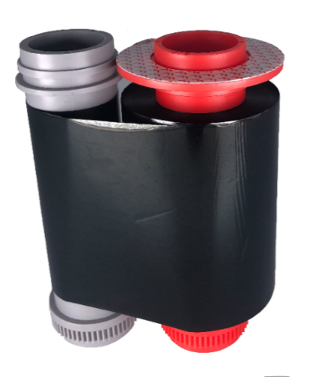
Consumables guide
MC310: Monochrome K (Black) ribbon 2,000 prints
The chromXpert® Monochrome K (black) ribbon is developed and harmonized for the use with Matica MC310 printers.
The ribbon consists of a continuous, 145m/475ft thermal transfer black resin film (K)
This ribbon is perfect to print crisp text, graphics and barcodes in solid black color on a PVC card.
The Monochrome K (black) ribbon comes with an embedded RFID tag for automatic ribbon detection in the MC310 printer. Detecting the correct RFID tag, the MC310 automatically set the optimized printer parameters to always ensure the best printing quality. The embedded RFID tag can also be programmed with a unique customer or project code to prevent the use of non-authorized ribbons, which might cause problems with the printer and will not provide the expected print quality.
Storage Conditions:
Temperature: < 25°C Humidity: less than 60% (non-condensing) Storage: Dry and dark place Shelf life-time: 12 month
Operating Conditions:
Temperature: 15°C – 30°C Humidity: 30-70% (non-condensing)
MC310 Monochrome K ribbon dimensions:

Slide 17
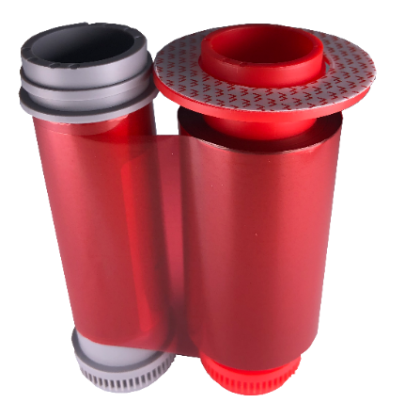
Consumables guide
MC310: Monochrome Red ribbon 1,000 prints
The chromXpert® Monochrome Red ribbon is developed and harmonized for the use with Matica MC310 printers.
The ribbon consists of a continuous, 72m/236ft thermal transfer red resin film
This ribbon is perfect to print crisp text and graphics in solid red color on a PVC card.
The Monochrome Red ribbon comes with an embedded RFID tag for automatic ribbon detection in the MC310 printer. Detecting the correct RFID tag, the MC310 automatically set the optimized printer parameters to always ensure the best printing quality. The embedded RFID tag can also be programmed with a unique customer or project code to prevent the use of non-authorized ribbons, which might cause problems with the printer and will not provide the expected print quality.
Storage Conditions:
Temperature: < 25°C Humidity: less than 60% (non-condensing) Storage: Dry and dark place Shelf life-time: 12 month
Operating Conditions:
Temperature: 15°C – 30°C Humidity: 30-70% (non-condensing)
MC310 Monochrome Red ribbon dimensions:

Slide 18
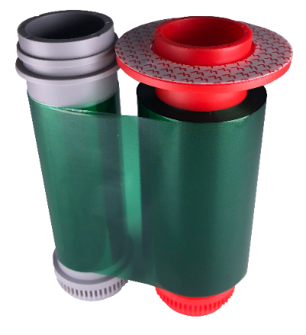
Consumables guide
MC310: Monochrome Green ribbon 1,000 prints
The chromXpert® Monochrome Green ribbon is developed and harmonized for the use with Matica MC310 printers.
The ribbon consists of a continuous, 72m/236ft thermal transfer Green resin film
This ribbon is perfect to print crisp text and graphics in solid Green color on a PVC card.
The Monochrome Green ribbon comes with an embedded RFID tag for automatic ribbon detection in the MC310 printer. Detecting the correct RFID tag, the MC310 automatically set the optimized printer parameters to always ensure the best printing quality. The embedded RFID tag can also be programmed with a unique customer or project code to prevent the use of non-authorized ribbons, which might cause problems with the printer and will not provide the expected print quality.
Storage Conditions:
Temperature: < 25°C Humidity: less than 60% (non-condensing) Storage: Dry and dark place Shelf life-time: 12 month
Operating Conditions:
Temperature: 15°C – 30°C Humidity: 30-70% (non-condensing)
MC310 Monochrome Green ribbon dimensions:

Slide 19
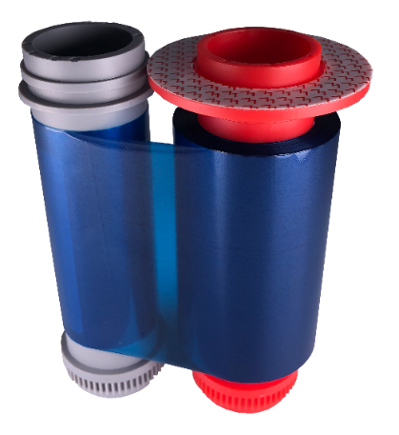
Consumables guide
MC310: Monochrome Blue ribbon 1,000 prints
The chromXpert® Monochrome Blue ribbon is developed and harmonized for the use with Matica MC310 printers.
The ribbon consists of a continuous, 72m/236ft thermal transfer Blue resin film
This ribbon is perfect to print crisp text and graphics in solid Blue color on a PVC card.
The Monochrome Blue ribbon comes with an embedded RFID tag for automatic ribbon detection in the MC310 printer. Detecting the correct RFID tag, the MC310 automatically set the optimized printer parameters to always ensure the best printing quality. The embedded RFID tag can also be programmed with a unique customer or project code to prevent the use of non-authorized ribbons, which might cause problems with the printer and will not provide the expected print quality.
Storage Conditions:
Temperature: < 25°C Humidity: less than 60% (non-condensing) Storage: Dry and dark place Shelf life-time: 12 month
Operating Conditions:
Temperature: 15°C – 30°C Humidity: 30-70% (non-condensing)
MC310 Monochrome Blue ribbon dimensions:

Slide 20
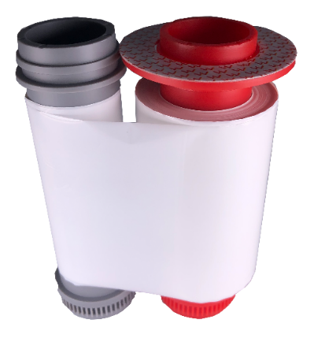
Consumables guide
MC310: Monochrome White ribbon 1,000 prints
The chromXpert® Monochrome White ribbon is developed and harmonized for the use with Matica MC310 printers.
The ribbon consists of a continuous, 72m/236ft thermal transfer White resin film
This ribbon is perfect to print crisp text and graphics in solid White color on a PVC card.
The Monochrome White ribbon comes with an embedded RFID tag for automatic ribbon detection in the MC310 printer. Detecting the correct RFID tag, the MC310 automatically set the optimized printer parameters to always ensure the best printing quality. The embedded RFID tag can also be programmed with a unique customer or project code to prevent the use of non-authorized ribbons, which might cause problems with the printer and will not provide the expected print quality.
Storage Conditions:
Temperature: < 25°C Humidity: less than 60% (non-condensing) Storage: Dry and dark place Shelf life-time: 12 month
Operating Conditions:
Temperature: 15°C – 30°C Humidity: 30-70% (non-condensing)
MC310 Monochrome White ribbon dimensions:

Slide 21
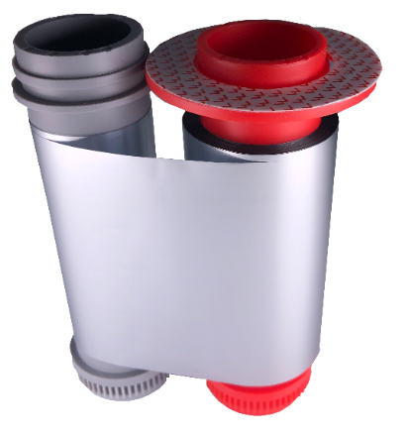
Consumables guide
MC310: Monochrome Silver ribbon 500 prints
The chromXpert® Monochrome Silver ribbon is developed and harmonized for the use with Matica MC310 printers.
The ribbon consists of a continuous, 40m/131ft thermal transfer silver metallic resin film.
This ribbon is perfect to print crisp text and graphics in solid metallic silver color on a PVC card.
The Monochrome Silver comes with an embedded RFID tag for automatic ribbon detection in the MC310 printer. Detecting the correct RFID tag, the MC310 automatically set the optimized printer parameters to always ensure the best printing quality. The embedded RFID tag can also be programmed with a unique customer or project code to prevent the use of non-authorized ribbons, which might cause problems with the printer and will not provide the expected print quality.
Storage Conditions:
Temperature: < 25°C Humidity: less than 60% (non-condensing) Storage: Dry and dark place Shelf life-time: 12 month
Operating Conditions:
Temperature: 15°C – 30°C Humidity: 30-70% (non-condensing)
MC310 Monochrome Silver ribbon dimensions:

Slide 22
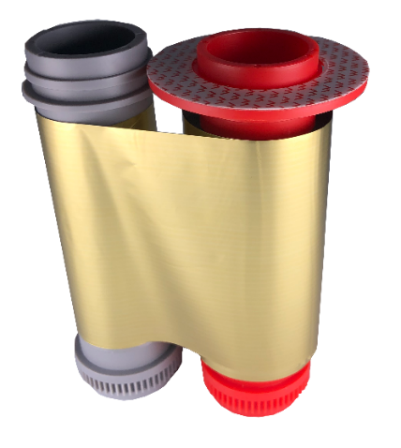
Consumables guide
MC310: Monochrome Gold ribbon 500 prints
The chromXpert® Monochrome Gold ribbon is developed and harmonized for the use with Matica MC310 printers.
The ribbon consists of a continuous, 40m/131ft thermal transfer Gold metallic resin film.
This ribbon is perfect to print crisp text and graphics in solid metallic Gold color on a PVC card.
The Monochrome Gold comes with an embedded RFID tag for automatic ribbon detection in the MC310 printer. Detecting the correct RFID tag, the MC310 automatically set the optimized printer parameters to always ensure the best printing quality. The embedded RFID tag can also be programmed with a unique customer or project code to prevent the use of non-authorized ribbons, which might cause problems with the printer and will not provide the expected print quality.
Storage Conditions:
Temperature: < 25°C Humidity: less than 60% (non-condensing) Storage: Dry and dark place Shelf life-time: 12 month
Operating Conditions:
Temperature: 15°C – 30°C Humidity: 30-70% (non-condensing)
MC310 Monochrome Gold ribbon dimensions:

Slide 23
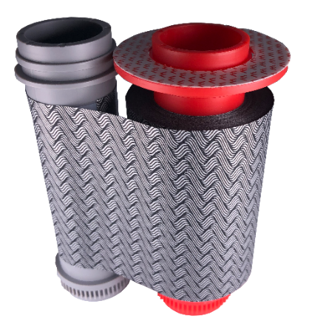
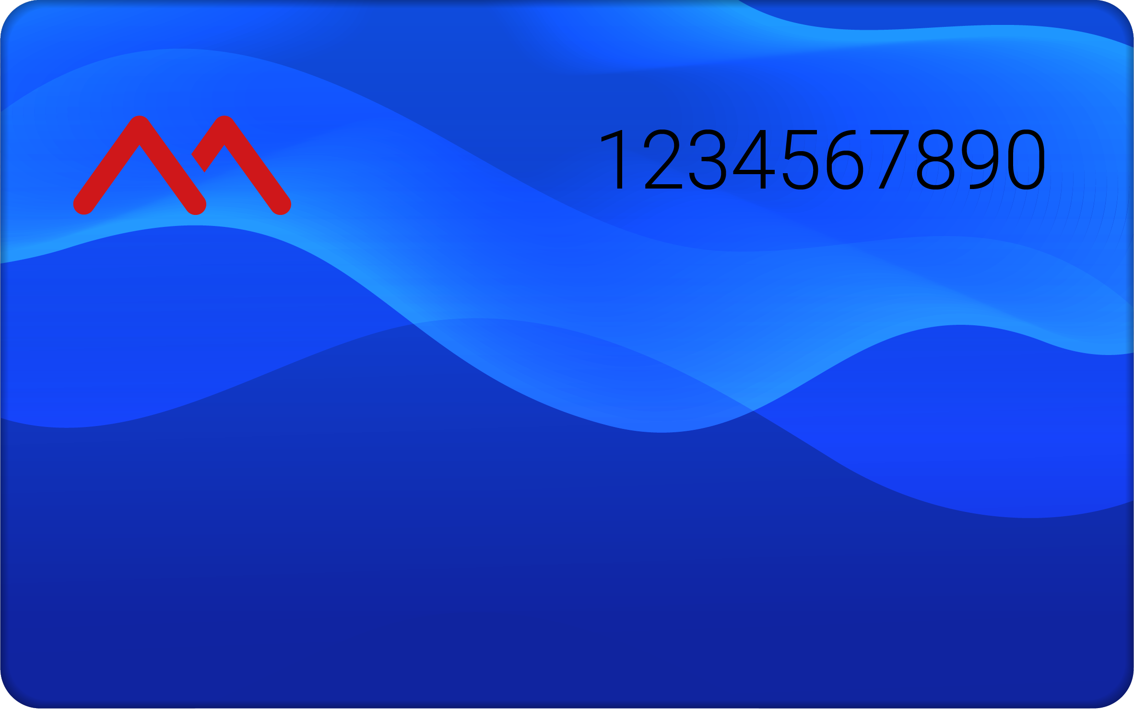
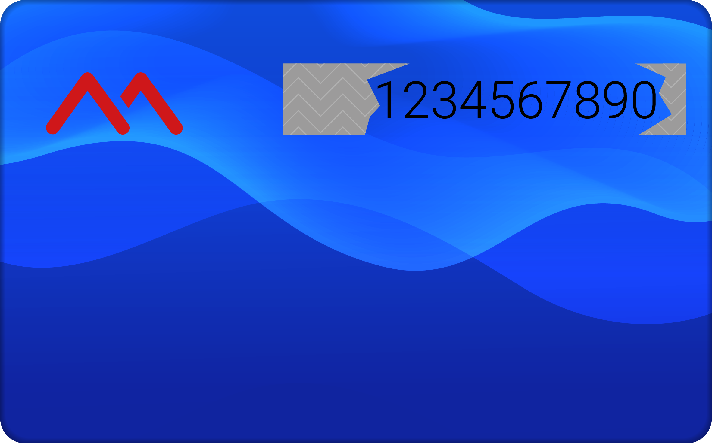
Consumables guide
MC310: Scratch-off ribbon 1,000 prints
The chromXpert® Scratch-off ribbon is developed and harmonized for the use with Matica MC310 printers.
The ribbon consists of a continuous, 72m/236ft thermal transfer scratch-off resin film.
The Scratch-off ribbon comes with an embedded RFID tag for automatic ribbon detection in the MC310 printer. Detecting the correct RFID tag, the MC310 automatically set the optimized printer parameters to always ensure the best printing quality. The embedded RFID tag can also be programmed with a unique customer or project code to prevent the use of non-authorized ribbons, which might cause problems with the printer and will not provide the expected print quality.
Step 1:
Print card with MC310 using normal i.e.YMCKO ribbon
Step 2:
Load Scratch-Off ribbon and mark the area to be covered on the card in the driver.
Print the marked area to cover the printed information
Step 3:
The user can scratch-off the applied foil and see the hidden information, such as a PIN Code
Storage Conditions:
Temperature: < 25°C Humidity: less than 60% (non-condensing) Storage: Dry and dark place Shelf life-time: 12 month
Operating Conditions:
Temperature: 15°C – 30°C Humidity: 30-70% (non-condensing)
MC310 Scratch-off ribbon dimensions:

Slide 24
Ribbons
Consumables guide 2022
Thank you
Grazie!
Vielen Dank!
Merci!
¡Muchas gracias!
Muito Obrigado
Спасибо!
! شكرا
ありがとう!
谢谢!
謝謝!
Terima kasih!

